Slide 1
Proof Of Concept SEM: Stream Finance & Admin
18-9-2020 – Work & Discussion Document

Slide 2
Contents
Stream members
Stream goals
Stream approach: Review & Design
Way of work
Agenda
Action list
Feedback Steering Committee
What is an Organization?
Appendix
Starting points
Transaction
Feedback Steering Committee
Holidays
Break-out sessions

Slide 3
Stream Members
Publisher:
Patricia Hoos (patricia.hoos@malmberg.nl, 06-52778412)
Dennis Wassink (d.wassink@boom.nl, 06-53710296)
Sander Aikema (s.aikema@noordhoff.nl, 06-22327252)
Distributor:
Jerry Plate (jerry.plate@iddinkgroup.com, 06-31908728)
Simon van Huffelen (Simon.vanhuffelen@thelearningnetwork.nl, 06-51808704)
LMS/ELO/IDP:
Erik Dikkers (Erik.Dikkers@topicus.nl, 06-54322615)
Architecture:
Edwin Verwoerd (edwin.verwoerd@iddinkgroup.com, 06-29096400)
Stream lead:
Marcel Untied (m.untied@ziggo.nl, 06-14812241)

Slide 4
Stream Goals
Buyers and users are not bothered with the transactions between partners in the ecosystem
Transactions between partners are traceable and transparent
Balanced administrations for all partners
Simplify administrative processes between partners

Slide 5
Stream Approach
REVIEW
The proposed processes and developed solutions of the other work streams are reviewed. The review will be based on the defined stream goals
DESIGN
The work stream can make adjustments to proposals/solutions and can design additional use cases to support the stream goals

Slide 6
Way Of Work
Weekly appointment
Weekly planned
Time window based on the expected amount of work
Stream lead will collect input and bundle information
Stream lead is responsible for communication to other work streams and steering committee
Reviews of processes and solutions will take place after introduction/demonstration by the team lead and/or team member(s) from the work streams

Slide 7
Agenda 18-9-2020
Actions
Discuss technical solution vs. administrative dataflow

Slide 8
Action List
Update track with outcome OSR & RIO Sessions
1-10-2020, Marcel

Slide 9
Discuss technical solution vs. administrative dataflow
Homework:
Map technical solution with administrative dataflow
Administrative data flow: 20200817 SEM POC FIN ADMIN Dataflow EV
Attachement in mail
Important sheets: 2 and 3
Technical solution
Homepage: https://stichtingsem.stoplight.io/
Entitlement overview: https://stichtingsem.stoplight.io/docs/sem-technology-prototype/reference/entitlement.v1.yaml
Entitlements API: https://stichtingsem.stoplight.io/docs/sem-technology-prototype/reference/entitlement.v1.yaml/components/schemas/Entitlements

Slide 10
Discuss technical solution vs. administrative dataflow
Role of school in ecosystem is important, but can they handle it?
Pilot has to contain real setup flows to validate if this can work
Experiences in the current chain show schools don’t have enough knowledge which lead to errors in the delivery of and access to learning material
Technical solution contains all required fields for a valid transaction, but:
Entitlement contains (to) many required (and optional) fields
Discuss purpose and target binding with technical stream (next phase)
Examples:
Business model
Duplication of data:
Title (name), URL of EAN in interface
School name
Group (structure)
Does the source always contain all the correct and actual data?
Status entitlement from LA to MP and LMS in separate service/call
Example: entitlement quantity vs. quantity in use
Determine owner of data parts

Slide 11
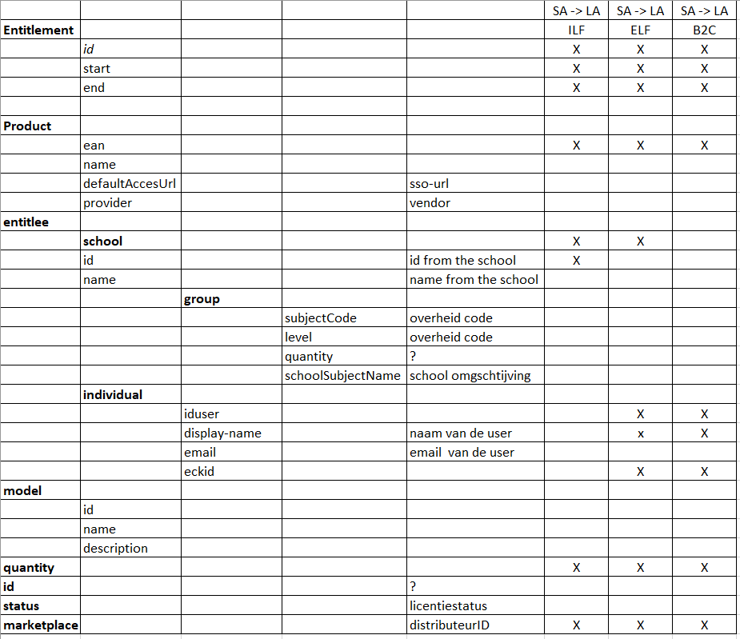
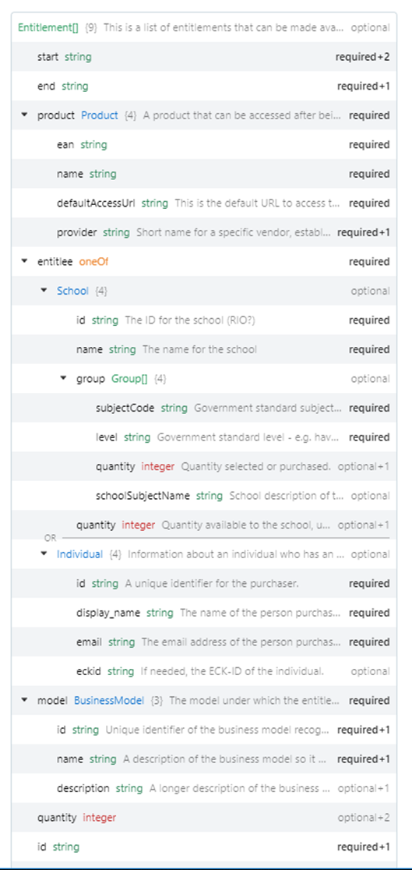
Discuss technical solution vs. administrative dataflow

Slide 12
Appendix
Documentation
Preparations
Starting Points
Transaction
Feedback Steering Committee
Holidays
Breakout Sessions

Slide 13
Documentation
Feedback Board Meeting 27-8-2020
Introduction/Explanation technical track by Clifton
Risks & Dangers
Work Stream Decisions

Slide 14
Feedback board meeting 27-8-2020
Positive about the progress made by the tracks so far
Marchien & Albert want to thank everybody for their input in the last months
The board wants more certainty on meeting the target ‘10 times better’ and clarity on the financial impact
A small group is working on a plan for the next phase(s) which will be presented to the SEM board on 23 September
The small group consists out of the track leads and members of the steering committee
The plan will contain a roadmap and program structure for the coming phase(s)
This will be the last meeting in the current setting, but hope that everybody will take part in the next phases and in the new structure
Preparation of the next phase will go on. For example: Plan preparation meetings (Edwin, Erik, Marcel) to investigate applicability of RIO and OSR
Progress will be shared

Slide 15
Introduction/Explanation technical track by Clifton
Periodic alignment between technical and financial track necessary
Clifton will introduce/explain technical documentation in next session (23-8)
The use/applicability of business model in entitlement service/API is not immediately endorsed by the Finance & Admin track
Preparation documentation for next session:
20200817 SEM POC FIN ADMIN Dataflow EV
https://github.com/stichtingsem/technology-prototype
https://stichtingsem.stoplight.io/

Slide 16
Risks & Dangers SEM Pilot
Bring and hold things together to start the realization of the pilot
All
Availability and commitment of partners in the ecosystem
Dennis, Patricia, Marcel
Target and benefits of the pilot not clear
Edwin, Patricia
Manage expectations in- and outside SEM
Jerry, Marcel
Scope and size of pilot
Erik, Edwin, Marcel
To start realization more elaboration necessary
Edwin

Slide 17
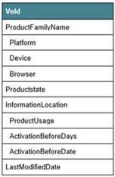
Work stream decisions
18-8-2020
Pre-competitive catalog data from LA to MP/LMS
Catalog service ECK 2.3 + additional attributes
https://www.edustandaard.nl/app/uploads/2020/02/ECK-Distributie-en-Toegang-2.3-Servicebeschrijvingen.pdf
https://developers.wiki.kennisnet.nl/index.php?title=Standaarden:ECK-DT/CatalogService
https://raw.githubusercontent.com/kennisnet/edurep-files/master/example/catalogservice-entry-2.3-full.xml

Slide 18
Discuss additional required catalog data
Work Stream Decision: Use of ECK 2.3 Catalog Service without additional requirements (like koppelpunt)
Product Family Name
Platform
Device
Browser
Product State
Information Location
Product Usage
Activation Before Days
Activation Before Date
Last Modified Date

Slide 19
Work stream decisions
23-7-2020
Which usage information will be available to LMS and MP
School ID
EAN
Active

Slide 20
Next Steps & Open Ends
Evaluate RIO as identifier for (school) organisations
Evaluate OSR as possible service registration model
Determine implementation guidelines
Determine setup scenarios
Clarity events, get functionality
Discuss sad flows (unhappy)
Make relations between marketplace and learning application more clear
Functionality and layers of Entitlement
Determine scope and role-out SEM pilot
Determine way to involve pilot schools

Slide 21
Preparations
RIO as identifier for (school) organizations
Setup use cases - Evaluate OSR model

Slide 22
RIO as identifier for (school) organizations
How do we identify an organization?
Digital address:
Which services does the school use?
LMS (@realm)
LAS/SIS (DigideliveryID or RIO)
Physical address:
DigideliveryID or RIO
Aligned with schools
Based on: Postal code, House number, BRIN
Is this sufficient? (front door, back door)
RIO Session:
There are possibilities to use RIO for identification of organizations
Coverage 95% (Indication)
Less administration of organisation identifiers
Determine solution for private schools and other educational institutions
Conclusion: Arrange follow-up session to determine applicability of RIO
Experts:
Heiko Kiewit (heiko.kiewiet@duo.nl)
Friso Snijder (friso.snijder@duo.nl)
Gido de Koff (gido.dekoff@duo.nl)

Slide 23
Setup use cases - Evaluate OSR model
Evaluate OSR model for use in ecosystem
Identification of non commercial school organisations (DUO)
Identification of commercial school organisations (NON DUO)
Broadening of framework/standard
OSR uses Edukoppeling instead of Oauth
Alignment with functional after introduction of OSR
Martijn Nagtegaal: M.Nagtegaal@kennisnet.nl
Marjan Frijns: M.Frijns@kennisnet.nl
How to Identify of partners and their services in the ecosystem
Distributors, publishers, etc.

Slide 24
Next Steps & Open Ends
Evaluate RIO as identifier for (school) organisations
Evaluate OSR as possible service registration model
Determine implementation guidelines
Examples:
Visibility of access links/URL’s based on validity period is the responsibility of the LMS
School is responsible for validity period of products that are shorter then the validity period of a LML
Determine start date in LML
Determine start date based on first access
Setup scenarios
Events, Get functionaliteit
Sad flow (Unhappy)
Relatie MP – LA > Helder maken
Entitlement gelaagdheid

Slide 25
Starting Points

Slide 26
Service credits still necessary? https://github.com/stichtingsem/functional-overview/issues/9
(Proposed) decision: Service credits are no longer needed. Entitlements will be sufficient to ensure access for users and balanced administrations for partners in the ecosystem
Point of attention: There has to be an entitlement (at front) with sufficient quantity to grant access to users
Steering Committee:
Users should always have access without limitations
School (customer/buyer) can impose limitations to access
School (LMC) is in the lead
Data is (near) real time available and transparent for partners in the ecosystem
Create service that gives insights on the active access links/URL’s within a LMS
Share these insights with involved partners (MP, LA) in the ecosystem

Slide 27
Is entitlement sufficient? https://github.com/stichtingsem/functional-overview/issues/10
Entitlements should be established upfront and can be realized (near) real time to ensure access for users
Steering Committee:
The ecosystem is based on trust and transparency
Determine the data needed to carry out roles within ecosystem. This data should be available within ecosystem to ensure trust and transparency
Entitlements will be established on the highest possible level
VO: School level
Data: Sales Agent, School, EAN, Quantity, Validity Period, Start Date (Optional)
Quantity is conditional for balancing administrations within in the Ecosystem
Glossary: Entitlement in secondary education (VO) is comparable with ILF specification
MBO: User level
Data: Sales Agent, Gebruiker, EAN, Validity Period, Start Date (Optional)
Glossary: Entitlement in vocational education (MBO) is comparable with ELF specification

Slide 28
Blended learning as base design criteria https://github.com/stichtingsem/functional-overview/issues/11
Blended learning (Combi's/LiFo) is just like (full) digital and folio products in scope of this pilot and therefore are part of the (base) design criteria
Blended learning asks for additional requirements to partners in the ecosystem
Flexibility in delivery
Digital components are (near) real time accessible
Shortage of folio components can’t block the access to digital component(s)
Blended learning materials (combi’s/LiFo) remain one product number (EAN)
Entitlements (digital) and purchase orders (folio) need to be synced over time
Entitlement ensure access for users
Steering Committee
See comments > Is entitlement sufficient?, Service credits still necessary?
Entitlement guarantee transactions for partners

Slide 29
Full Digital: Sales invoice on usage? https://github.com/stichtingsem/functional-overview/issues/12 Blended/Folio: Sales invoice on delivery of physical component https://github.com/stichtingsem/functional-overview/issues/13
Revenue recognition is influenced by tax legislation, competitive propositions and commercial contracts/agreements. Partners in the ecosystem should determine their own approach to revenue recognition but the services should ensure valid & transparent transactions and enable various transaction/commercial models
Steering Committee:
Ecosystem should support multiple business models (Prepaid, Post paid, subscription, premium, usage, etc)
Available business models should be available in the product catalog

Slide 30
Identity https://github.com/stichtingsem/functional-overview/issues/14
User: ECK-ID
School: Digi Delivery ID (RIO will be evaluated on applicability)
Product: EAN
Input
Good to start with these identifiers, but don’t limit the ecosystem on these identifiers
Create technical flexibility in the use of multiple/various identifiers

Slide 31
Bring SIS (LAS) and LML in sync https://github.com/stichtingsem/functional-overview/issues/15
SIS (LMS) data will be synced with LML
Boundaries:
Target binding based on role > minimize data
School is in control of the accessibility to the entities/data within SIS
Preparation phase:
Subjects
Courses
Execution phase:
Forecast (base for entitlement)

Slide 32
Data reliability and integrity https://github.com/stichtingsem/functional-overview/issues/16
First Time Right will not be a principle, but there are (additional) requirements:
Avoidance of errors and repairs
Determine when data is up to date and ready for use (data quality)
Updates (LML) will be shared (near) real time
It is a dynamic process and updates will prevent errors (and repairs)

Slide 33
In Scope: Points of Attention https://github.com/stichtingsem/functional-overview/issues/17
VO (secondary) and MBO (vocational)
Steering Committee:
MBO is in scope for the ecosystem
MBO is out of scope for the pilot
Full Digital (100% digital)
Blended (combi’s)
Folio (incl. paper vouchers)
Partners (SA, MP) within the eco-system have to evaluate the impact of the proposed solutions on their supply chain (forecasts/prognosis, purchase, stock, etc)
ECK

Slide 34
Out Of Scope:Next Steps https://github.com/stichtingsem/functional-overview/issues/18
Setup & Support
Most important next step in the SEM pilot
More decentralized = more risk > How to reduce risk?
Communication
School processes / administration (SIS, ELO, IDP)
Not enrolled students (0e Jaars)
Teacher licenses (including trial licenses)
Additional services for teachers > prepare access locations for teacher licenses
Kennisnet ARP administration
Progress & Results (Part of Use Case 4.0)
Steering Committee
In scope for the Ecosystem
Out of scope for the pilot
Data covenant
Non happy flows
Returns
Return reasons: Changes LML (school), Mutations SIS (change of subjects, OKO
NON ECK

Slide 35
Transaction

Slide 36
Transaction within the new ecosystem
Out-Of-Scope
Finance & Admin
Out-Of- Scope
POC
In Scope
POC

Slide 37
Transaction within the new ecosystem
UC 1.0
Create & Finalize LML
UC 2.0
Confirm Order
UC 3.0
Deliver Order
UC 4.0
(First) Use of Content
UC 5.0
Buy & Use Additional
Use Cases
No Transaction
Start Transaction
Transaction
End Transaction
Additional Transaction
Transaction flow

Slide 38
Transaction within the new ecosystem
UC 1.0
Create & Finalize LML
UC 2.0
Confirm Order
UC 3.0
Deliver Order
UC 4.0
(First) Use of Content
UC 5.0
Buy & Use Additional
Use Cases
LMC
Sales Agent (MP)
Buyer/User
Sales Agent (MP)
Fulfilment Agent (MP)
LMS Provider
LA Provider
User
Sales Agent (MP)
Fulfilment Agent (MP)
Learning Management Provider
Learning Applications Provider
User
Learning Material Provider
Learning Management Provider
Sales Agent (MP)
LMC
Teacher
Sales Agent (MP)
Roles
- LML
- LML
- Shopping Basket
- Sales Order Confirmation
- Fulfilment Order(s)
- Packing Slip (Folio)
- Fulfilment Update LMS
- Fulfilment Update LA
- Entitlement
- Entitlement Update LMS
See UC 3.0 & 4.0
- Entitlement Control
- Sales Invoice
- (Buyer) Payment (Confirmation)
Entities / Services

Slide 39
Transaction within the new ecosystem Use Case 1.0 – 4.0 (Secondary Education) https://github.com/stichtingsem/functional-overview/issues/19 https://github.com/stichtingsem/functional-overview/issues/20
Discussion
LML
Shopping Basket
Order Confirmation
Fulfilment Order(s)
Fulfilment Update LMS
Fulfilment Update LA
Packing Slip
Entitlement Update LMS
Entitlement
Invoice
Update LMS
Entitlement (Control)
Usage Confirmation
Payment

Slide 40
Transaction within the new ecosystem Use Case 1.0 – 4.0 (Vocational Education – Pre-Paid)
Discussion
LML / Webshop / Catalog
Shopping Basket
Payment Options
Payment
Fulfilment Order(s)
Order Confirmation
Fulfilment Update LMS
Fulfilment Update LA
Entitlement
Packing Slip
Entitlement Update LMS
Update LMS
Access (Control)
Invoice

Slide 41
Transaction within the new ecosystem Use Case 5.0 (Additional Content)
Discussion
Catalog
Payment Options
Payment
Fulfilment Order(s)
Fulfilment Update
Fulfilment Update LA
Packing Slip
Entitlement Update LMS
Entitlement
Invoice
Update LMS
Access (Control)

Slide 42
Feedback Steering Committee

Slide 43
Feedback Steering Committee 9-7-2020
Service credits still necessary?
There has to be an entitlement (at front) with sufficient quantity to grant access to users
Steering Committee:
Users should always have access without limitations
School (customer/buyer) can impose limitations to access
School (LMC) is in the lead
Data is (near) real time available and transparent for partners in the ecosystem
Create service that gives insights on the active access links/URL’s within a LMS
Share these insights with involved partners (MP, LA) in the ecosystem
Is entitlement sufficient?
Entitlements should be established upfront and can be realized (near) real time to ensure access for users
Steering Committee:
The ecosystem is based on trust and transparency
Determine the data needed to carry out roles within ecosystem. This data should be available within ecosystem to ensure trust and transparency
Full Digital: Sales invoice on usage? / Blended & Folio: Sales invoice on delivery of physical component
Steering Committee
Ecosystem should support multiple business models (Prepaid, Post paid, subscription, premium, freemium, usage)
Available business models should be available in the product catalog

Slide 44
Feedback Steering Committee 9-7-2020
Identity
User: ECK-ID
School: Digi Delivery ID (RIO will be evaluated on applicability)
Product: EAN
Input sessions:
Good to start with these identifiers, but don’t limit the ecosystem on these identifiers
Create technical flexibility in the use of multiple/various identifiers
In Scope: Points of Attention
VO (secondary) and MBO (vocational)
Steering Committee:
MBO is in scope for the ecosystem
MBO is out of scope for the pilot
Progress & Results (Part of Use Case 4.0)
Steering Committee
In scope for the Ecosystem
Out of scope for the pilot

Slide 45
Holidays

Slide 46
Holidays Stream Menbers
Marcel Untied: Week 30, 31, 32, 33 (23 July – 16 August)
Patricia Hoos: Week 27 (29 June – 3 July)
Erik Dikkers: Week 31, 32 (27 July – 7 August)
Simon van Huffelen: Week 34 (14 August - 21 August)
Dennis Wassink: Week 32 (1 August – 9 August)
Jerry Plate: Week 31, 32 (27 July – 7 August)
Edwin Verwoerd: Week 31, 32, 33 (29 July – 17 August)

Slide 47
Break-Out Sessions

Slide 48
Break-Out Session 1
Introductions
Questions
Discuss Use Cases
https://github.com/stichtingsem/functional-overview/blob/master/use-cases/oa.3.0-sales-agent-delivers-products.md
https://github.com/stichtingsem/functional-overview/blob/master/use-cases/oa.4.0-user-accesses-delivered-products.md

Slide 49
Break-Out Session 2
Way of work
Starting points
In scope
Out of scope
Questions

